Slide 1
FLOOD Social Media Toolkit
Becca Doris | Community Outreach Specialist

Slide 2
Toolkit Information
Please feel free to use messaging and graphics on following slides. If you have any questions or would like more content, contact Becca Doris:
Becca.Doris@hamiltoncountyohio.gov
513-823-8986
Follow us on socials!
Twitter: @hcema twitter.com/HCEMA
Facebook: @Hamilton.CountyEMA www.facebook.com/hamilton.countyema/
Instagram: @hc_ema www.instagram.com/hc_ema/

Slide 3
Messaging
With heavy rain expected over the next few days, flash flooding could be possible. Always remember- turn around, don't drown! Never drive, walk or swim through flood waters! Get weather alerts: alerthc.org
Alert Hamilton County is the official emergency alert system for Hamilton County, Ohio. Sign up for emergency alerts like flood warnings & hazardous materials spills at alerthc.org. The best part is YOU get to choose what alerts you want to receive & how you will receive them!
With heavy rains and potential for flooding this week, how will you get flood alerts for your home and work address? Sign up for Alert Hamilton County to get text & email alerts for flooding in your area. Sign up: alerthc.org
Do you know the difference between a Flood Watch & a Flood Warning? Watch = Flooding is possible vs. Warning = Flooding is currently happening. Learn the terms so that you can TAKE ACTION.
Stay Weather Aware! Hamilton County is under a Flood Watch Thursday night into Saturday. Drive with caution during heavy rain, slow down & remember to turn headlights on. Be sure you can get emergency alerts & flood warnings straight to your phone: alerthc.org
Before excessive rainfall, relocate valuable & sentimental items from areas of your home prone to flooding or water seepage! Get them off the ground or move them to upper floors.

Slide 9
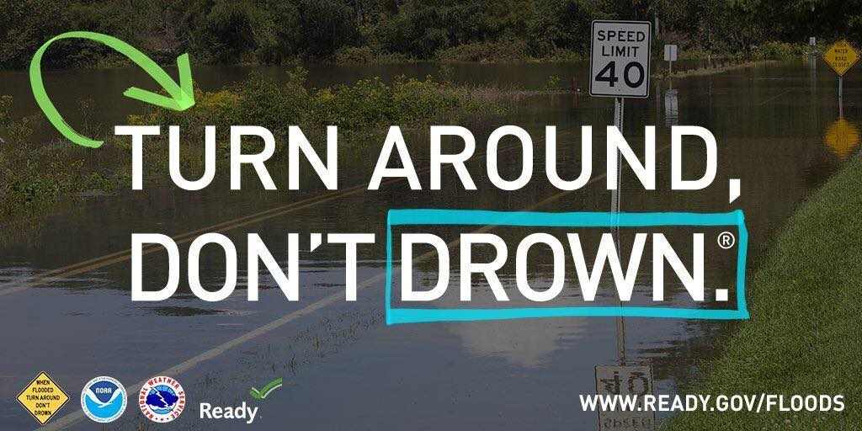

Slide 12
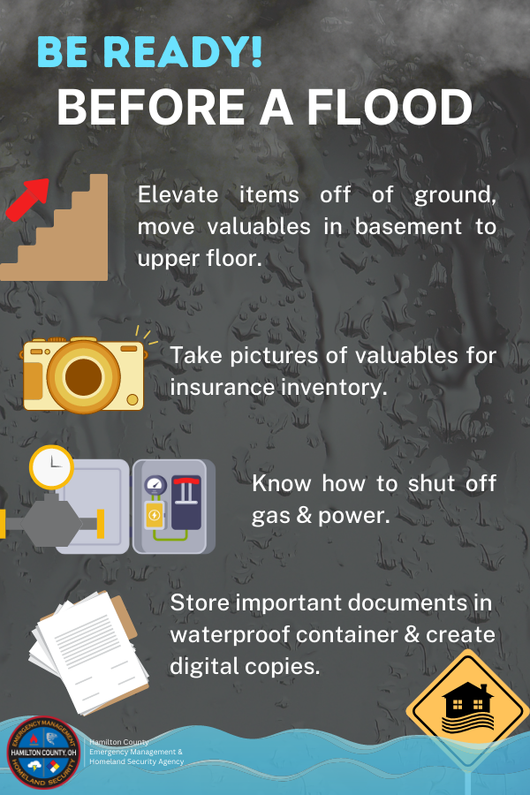

Slide 14
